Slide 1
Workshop in Data Science Tutorial 1
03/11/2025

Slide 2
Schedule and Administration
Form groups of 2-3 until EOW (In Moodle).
My email - omera1@mail.tau.ac.il – contact for meeting. (Monday 11-12)
Date | Schedule
10.11 | Tutorial 2
17.11, 24.11 | Initial idea presentation
15.12, 22.12 | Checkpoint
19.01, 22.01 | Final presentation
15.03 | Project Submission

Slide 3
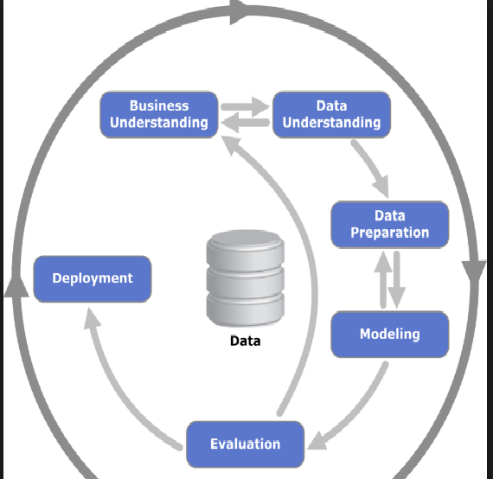
Data Science Pipeline

Slide 4
Today
Data Exploration
Data Cleaning
Some Visualization

Slide 5
Exploring your data (EDA)
Get a “feel” of the data
Understand data quality
Do we need more data?
What features can we take from the data?

Slide 6
How to read data?
Cats Dataset
Cat Color | Length | Height
Orange | 35 | 40
White | 40 | 50
Tabby | 10 | 20
Black | 20 | 20

Slide 7

How to read data?
Cats Dataset
Cat Color | Length(cm) | Height(cm)
Orange | 35 | 40
White | 40 | 50
Tabby | 10 | 20
Black | 20 | 20

Slide 8
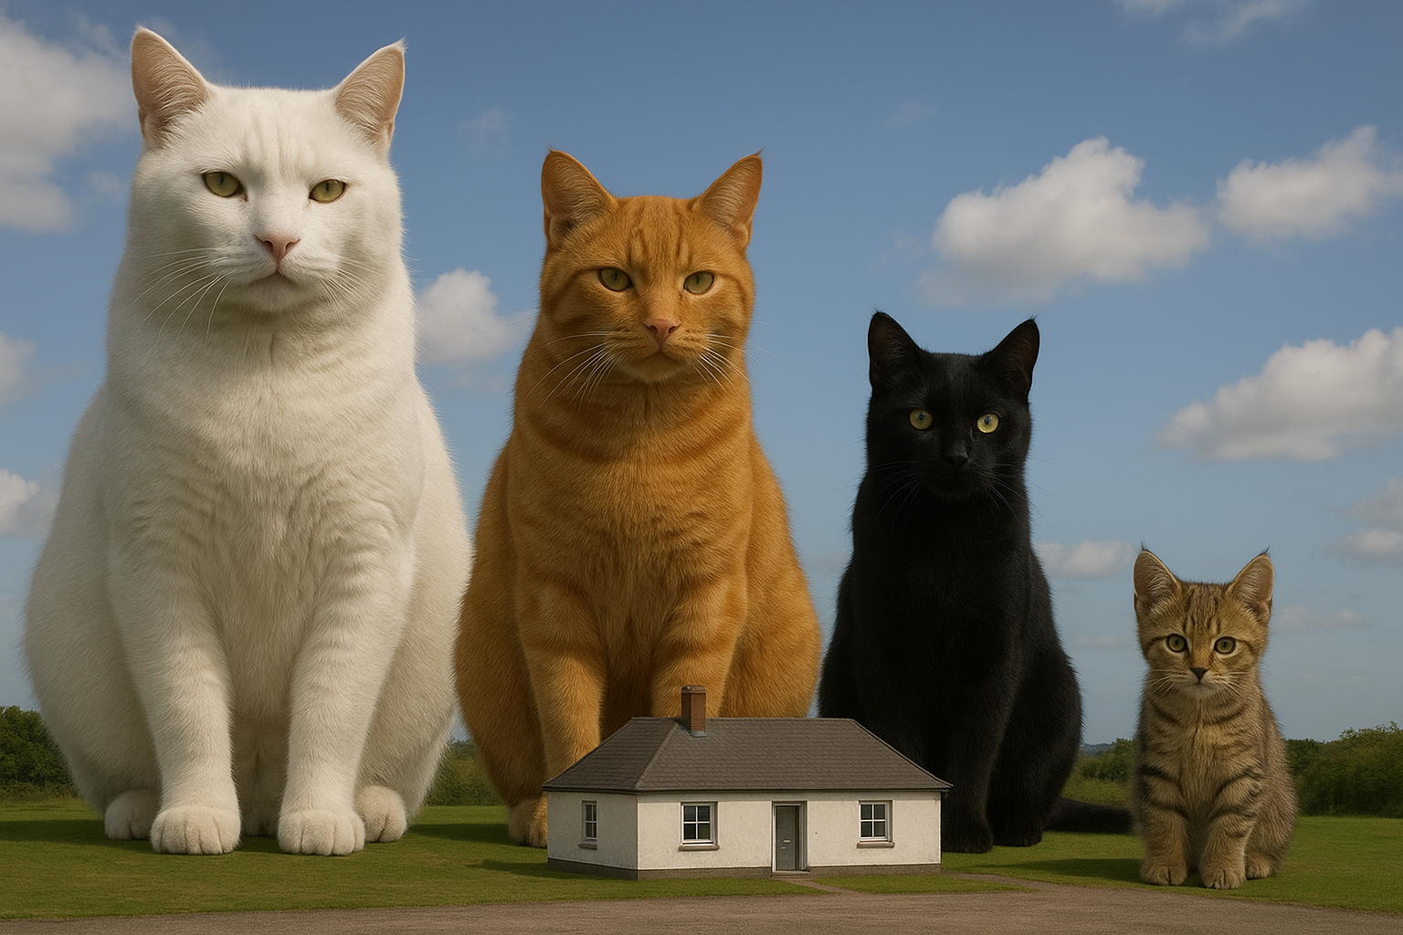
How to read data?
Cats Dataset
Cat Color | Length(m) | Height(m)
Orange | 35 | 40
White | 40 | 50
Tabby | 10 | 20
Black | 20 | 20

Slide 9

How to read data?
Cats Dataset
Cat Color | Length | Height
Orange | 35 | 40
White | 40 | 50
Tabby | 10 | 20
Black | 20 | 20
Length: 40 – short
35 – medium
10 – Long
20 – Very Long
Height:
10 -Short 40 – Medium
50 – Tall
20 – Very Tall

Slide 10
How to continue?
Look at the data
Perform basic analysis
What type of features do we have?
How do features behave?
Ho do different features correlate?
Do we have enough data?
What is the distribution of data?

Slide 11
Data Cleaning

Slide 12
Handling Missing Values – Why is it missing?
Missing Completely At Random
(MCAR)
Missing At Random
(MAR)
Missing Not At Random
(MNAR)
The data are MCAR when the chance that a value for a certain variable is missing is not linked to the value of other observed variables and not linked to the variable with the missing value itself.
The data are MCAR when the chance that a value for a certain variable is missing is linked to the value of other observed variables but not linked to the variable with the missing value itself.
The data are MNAR when the chance that a value for a certain variable is missing is linked to the value of that variable.

Slide 13
Outliers
Outliers are data points that are significantly different from most of the other observations.
Error in data measurement/preprocessing? (999$ instead of 9.99$)
Natural variability? (a rare but real event)
Sampling bias? (outliers are relative to the sample, not to reality)
Outliers can damage the performance of certain algorithms.

Slide 14
Outliers
If there are few, check them (if very few, do it manually)
If seem like errors, simply discard
Otherwise, may need a special treatment or adapting the distribution
If there are many, perhaps the inferred distribution was not correct
Apply tests

Slide 15
Normalization – Why?
Some algorithms require normalization

Slide 16
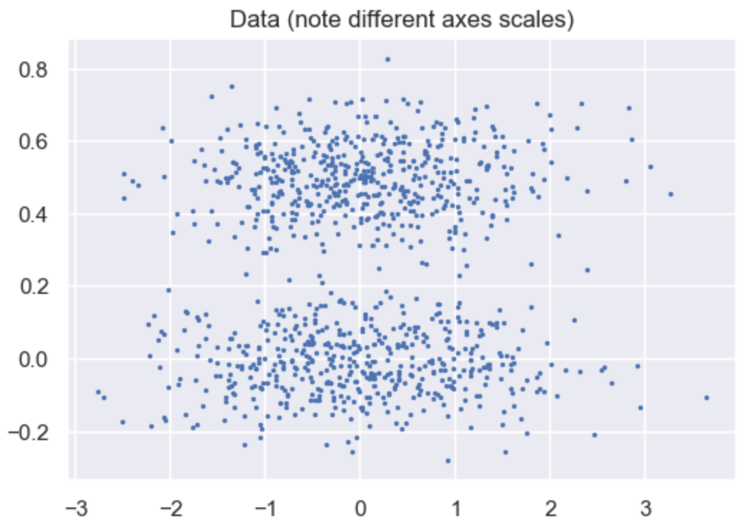
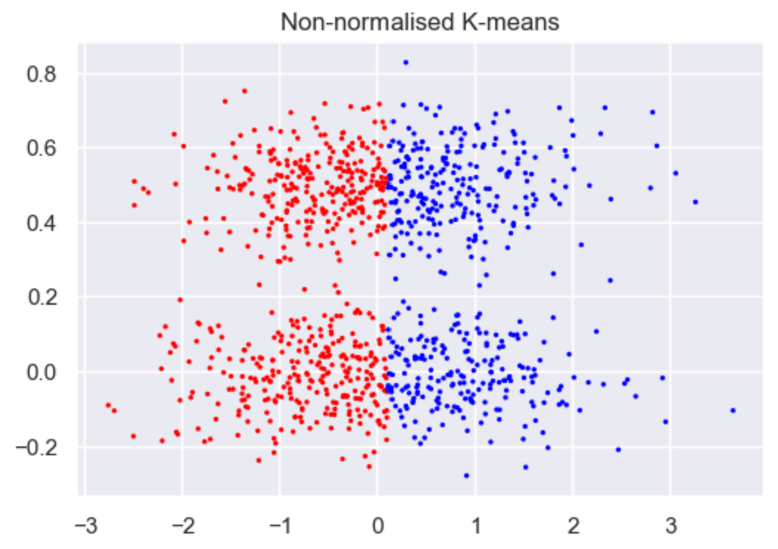
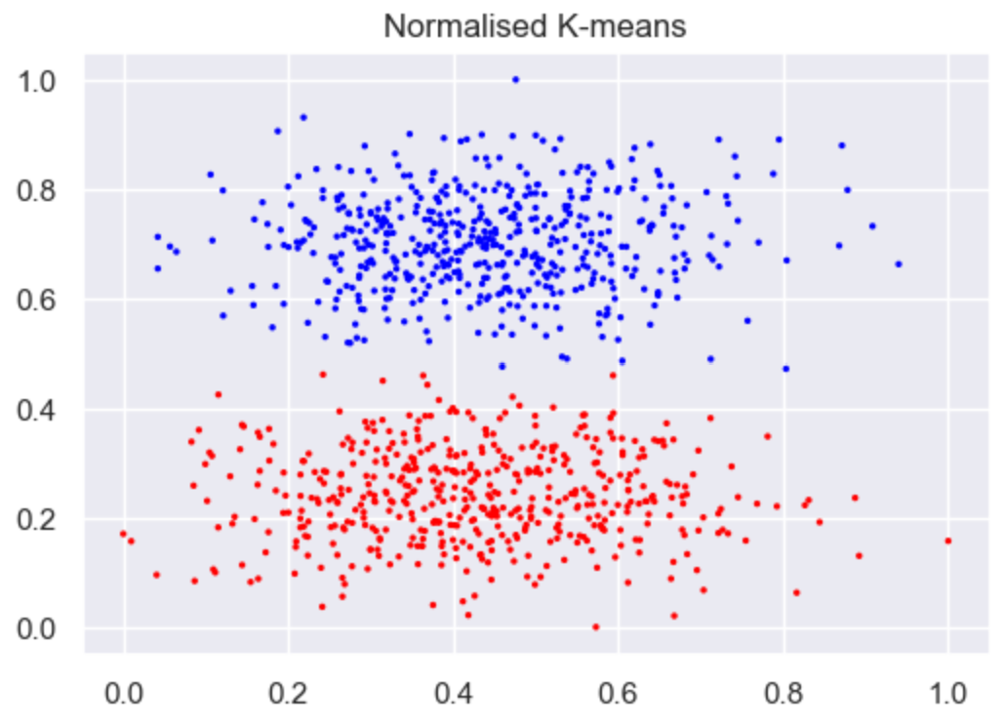
Normalization – Why?
Some algorithms require normalization

Slide 17
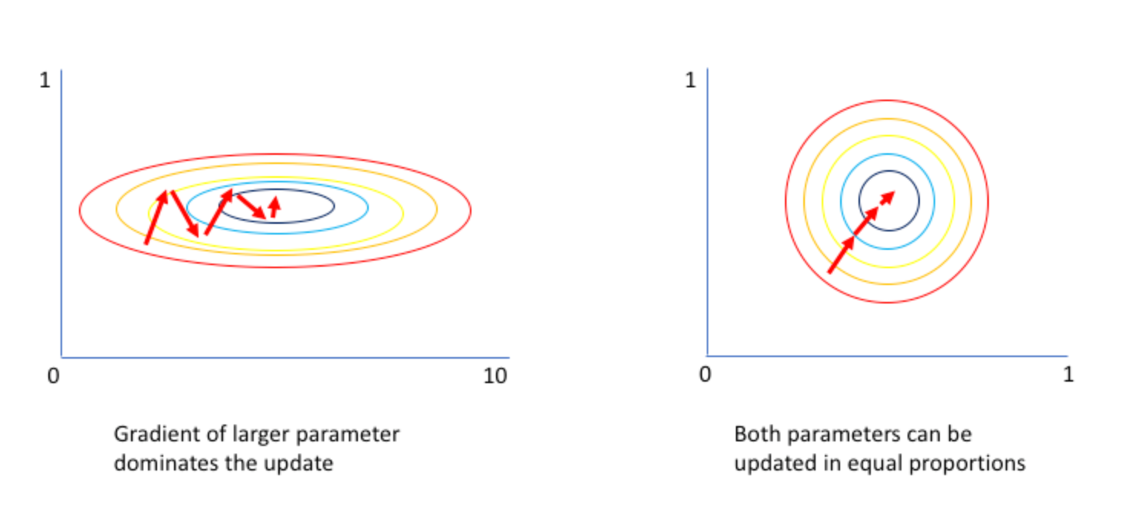
Normalization – Why?
Some algorithms require normalization
Some algorithms are faster with normalization

Slide 18
Normalization – Why?
Some algorithms require normalization
Some algorithms are faster with normalization
Normalized data is often more “explainable”

Slide 19
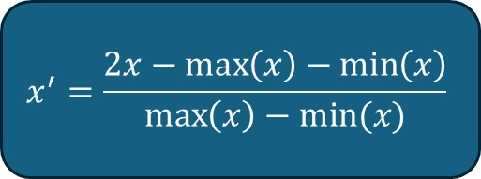
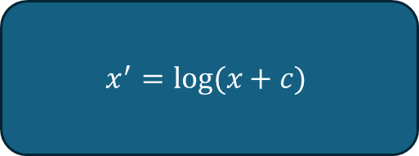
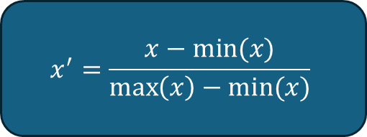
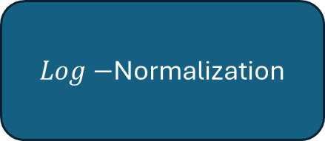
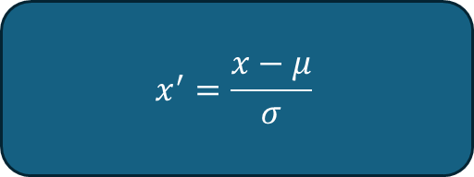
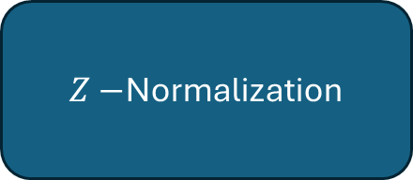
Normalization – basic methods
Simple Normalization to [0,1]
$$x^{′}=\frac{x−min⁡(x)}{\max\left(x\right)−min⁡(x)}$$
Simple Normalization to [-1,1]
$$x^{′}=\frac{2x−\max\left(x\right)−\min\left(x\right)}{\max\left(x\right)−min⁡(x)}$$
$Z−$Normalization
$$x^{′}=\frac{x−μ}{σ}$$
$Log−$Normalization
$$x^{′}=log⁡(x+c)$$

Slide 20
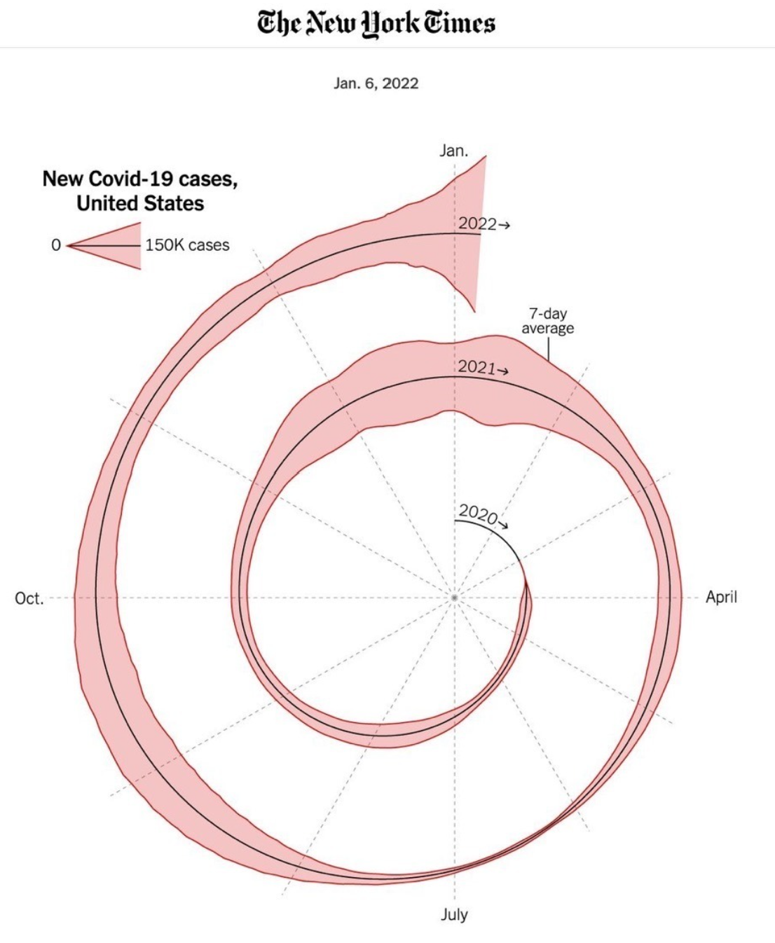
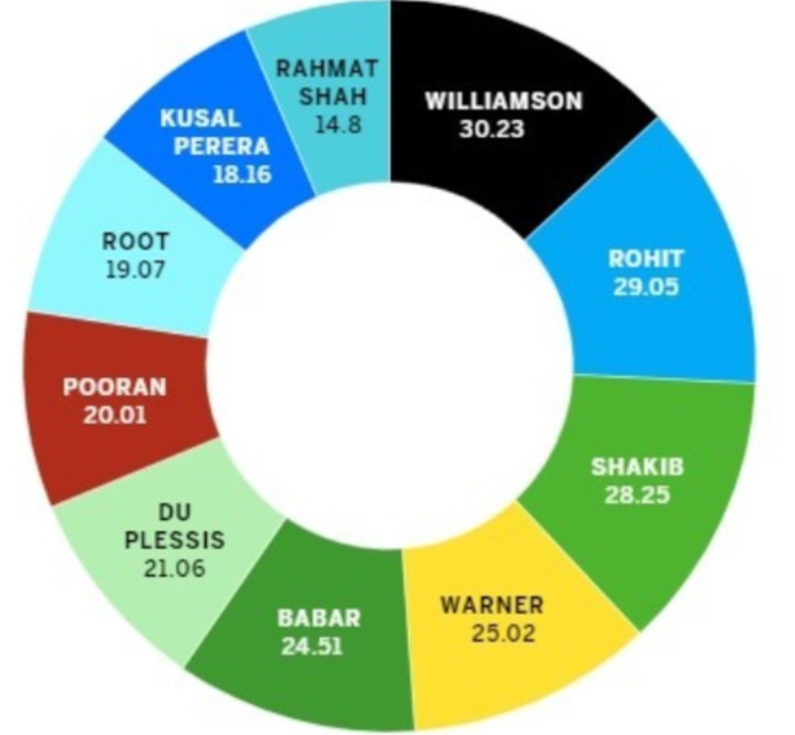
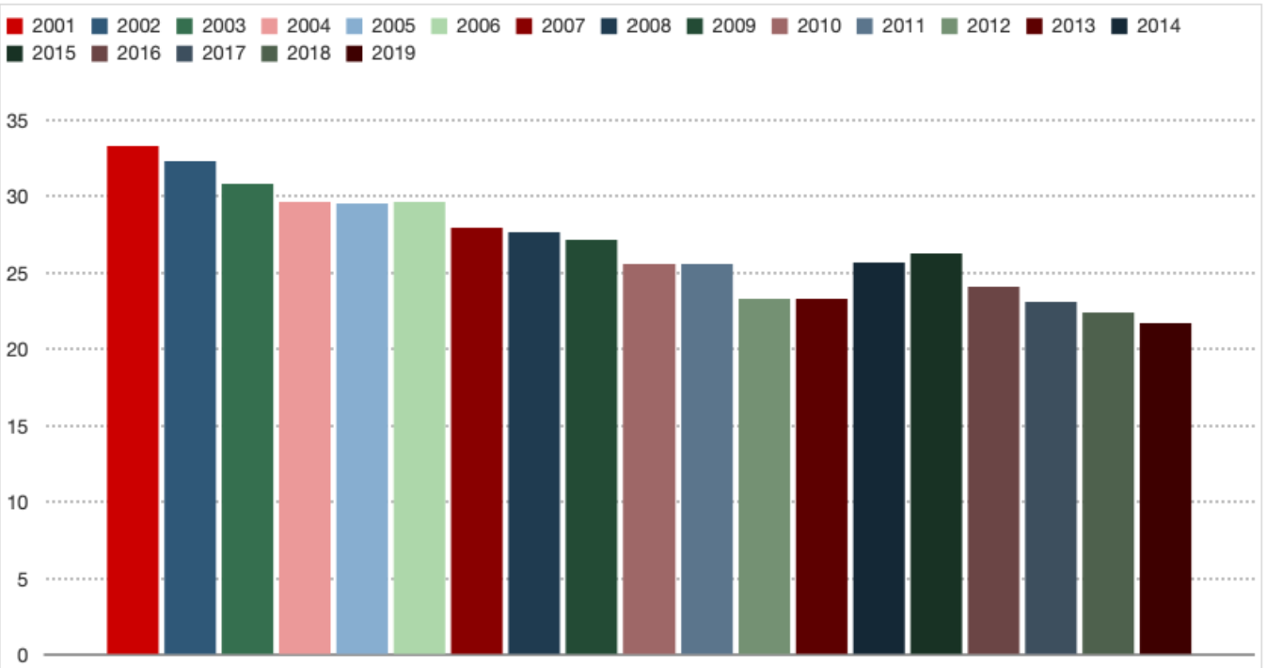
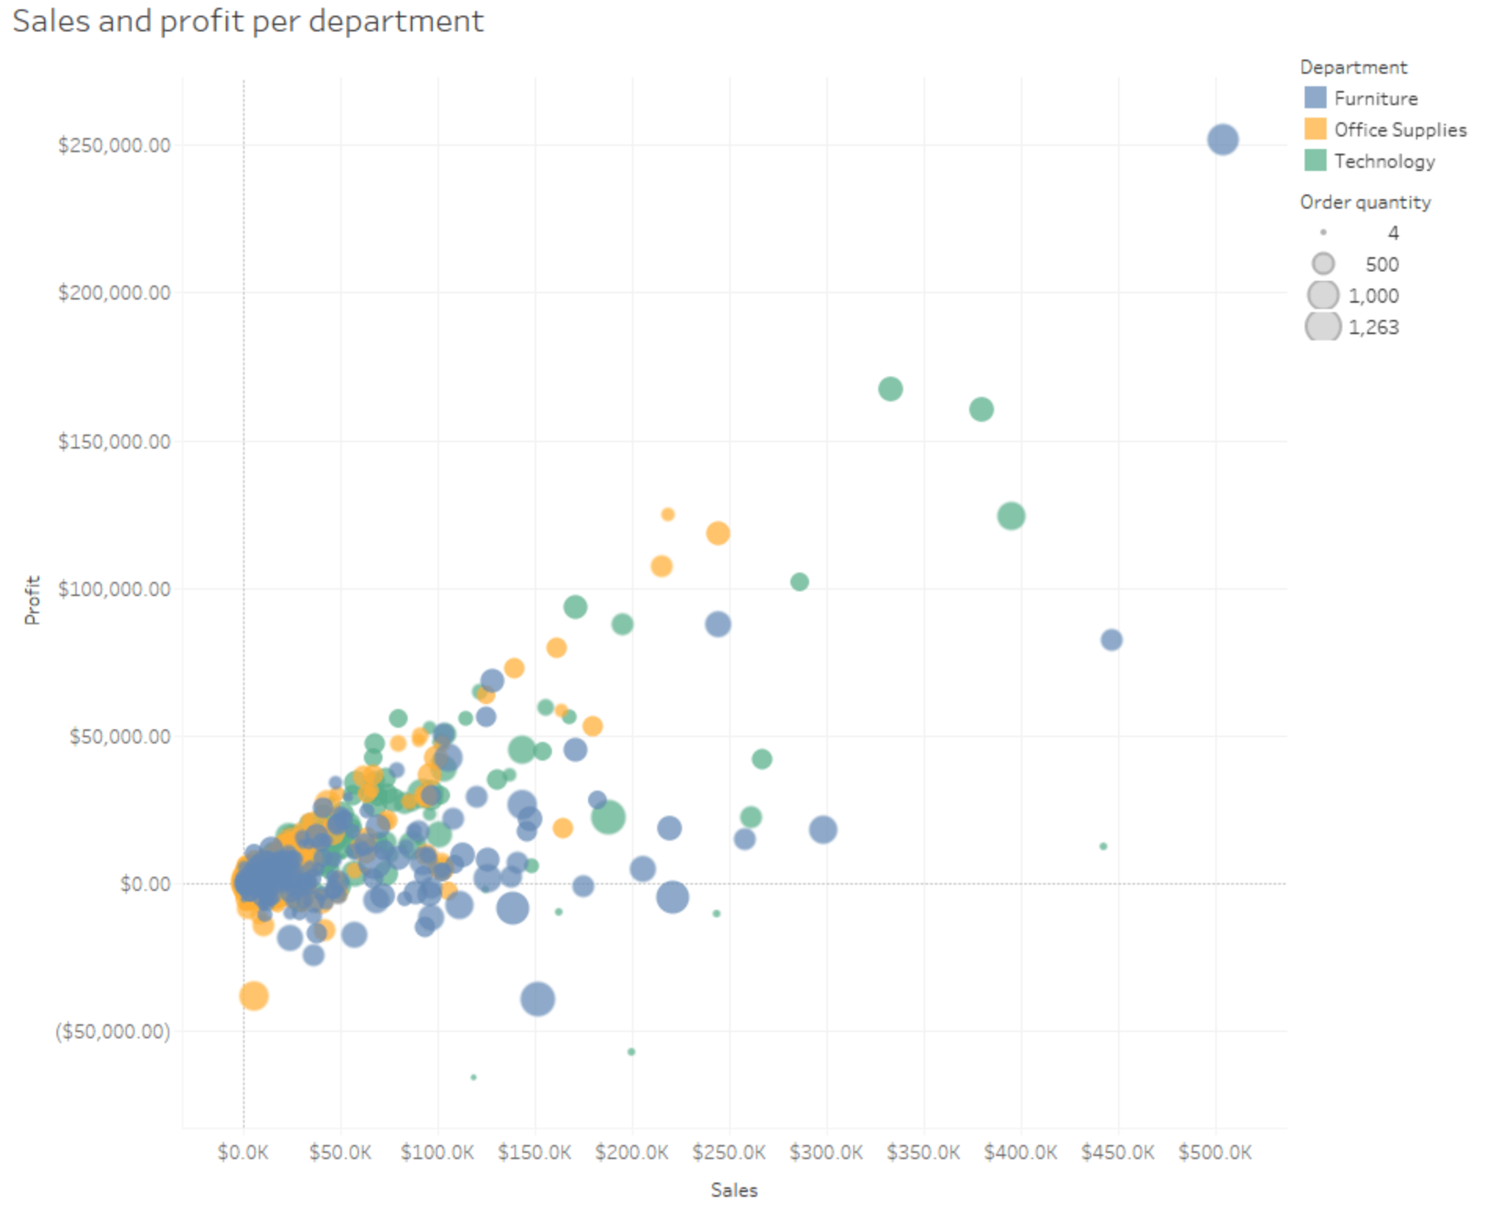
Visualization
Keep it Simple!
Choose the right chart for the message
Use color purposely
Always label axes and units
Choose the right Scale for the message

Slide 21
Questions?

